Slide 1
HRF Analysis Code Map
Michael Sun 05/26/2026

Slide 2
Basic Usage
run_hrf_pipeline(‘file.nii’, ‘events.tsv’, TR, WindowSeconds, Models, SignalSource, SimilarityMetric, ImageSet);
Collect Files
Run-level 4D Nifti Files
Events.tsv Files (BIDS Formatted)
Two Entryways:
Direct/Interactive: run_hrf_study_pipeline()
HCP: hrf_write_slurm_study_script()

Slide 3
Basic Usage – Run Level Pipeline
results = run_hrf_pipeline( ...
fmri_files{1}, ...
events_files{1}, ...
'TR', 0.46, ...
'WindowSeconds', 30, ...
'Models', {'fir', 'sfir', 'canonical', 'spline', 'nlgamma'}, ...
'SignalSource', 'signature', ...
'SimilarityMetric', 'dotproduct', ...
'ImageSet', 'all');
results = struct with fields: timeseries: [1486×1 double] events: [274×3 table] conditions: {1×19 cell} condition_groups: [19×1 struct] stick_functions: {1×19 cell} fits: [1×1 struct] settings: [1×1 struct] signature_meta: [1×1 struct] fits_by_signature: [1×1 struct] wholebrain_paths_by_model: [1×1 struct] wholebrain_metadata_by_model: [1×1 struct]

Slide 4
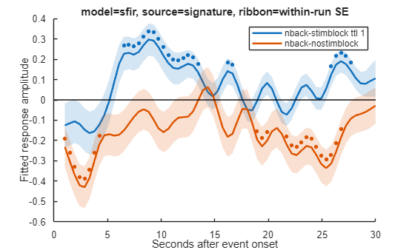
Basic Usage
plot_hrf_by_condition(results, 'Model', 'sfir’,
'Conditions', {'nback-stimblock_ttl_1','nback-nostimblock'});

Slide 5
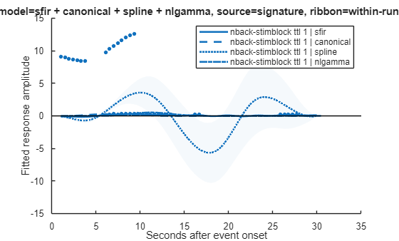
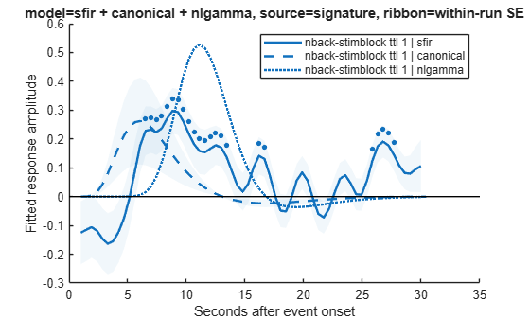
Basic Usage
plot_hrf_by_condition(results, ...
'Model', {'sfir','canonical', 'spline', 'nlgamma'}, ...
'Condition', 'nback-stimblock_ttl_1');
plot_hrf_by_condition(results, ...
'Model', {'sfir', 'canonical', 'nlgamma'}, ...
'Condition', 'nback-stimblock_ttl_1');
Model misspecification in canonical?
Check residuals if they deviate from random noise
Task-related pattern left?
Where is the mismodelling?
Add quantitative metrics for mismodelling
Systematic misvariance?
Power loss?
What is the best number?
Optimized overall HRF function agnostic of hypothesis and then t-test across conditions.
Maybe need cross-validation to get amplitude/AUC/Other performance.
Square root of the variance of the curves

Slide 6
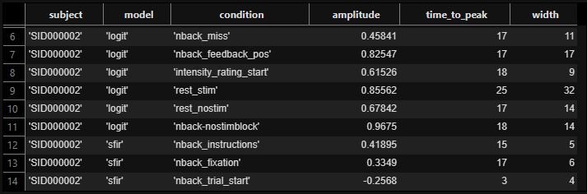
Study-Level Pipeline: Running Locally
study = run_hrf_study_pipeline(fmri_files, events_files, subject_ids, ...
'TR', 0.46, ...
'WindowSeconds', 30, ...
'Models', {'sfir', 'spline', 'canonical'}, ...
'WriteWholeBrain', true, ...
'WholeBrainOutputDir', output_dir, ...
'WholeBrainPThresh', 0.05, ...
'WholeBrainThreshType', 'fdr', ...
'UseParallelSubjects', true);
study.summary

Slide 7
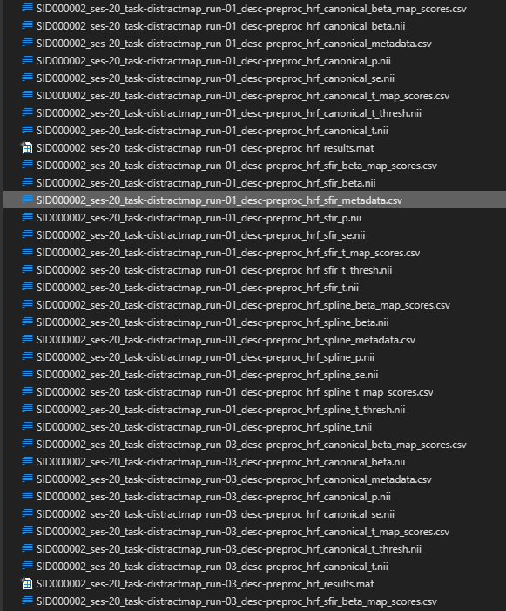
Study-Level Pipeline : Running Locally
output_dir = pwd;
for i = 1:numel(study.results)
if ~study.success(i), continue; end
prefix = fullfile(output_dir, [regexprep(subject_ids{i}, '[^\w.-]', '_') '_hrf']);
hrf_apply_maps_to_wholebrain(study.results{i}.wholebrain, ...
'Object', 'beta', ...
'SignatureSets', {'all'}, ...
'ImageSets', image_sets, ...
'SimilarityMetric', 'dotproduct', ...
'OutputCsv', [prefix '_beta_map_scores.csv']);
hrf_apply_maps_to_wholebrain(study.results{i}.wholebrain, ...
'Object', 't', ...
'SignatureSets', {'all'}, ...
'ImageSets', image_sets, ...
'SimilarityMetric', 'dotproduct', ...
'OutputCsv', [prefix '_t_map_scores.csv']);
end

Slide 8
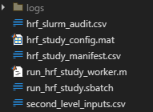
Study-Level Pipeline: HCP SLURM
slurm_paths = hrf_write_slurm_study_script(fmri_files, events_files, subject_ids, ...
'OutputDir', '//dartfs-hpc/rc/lab/C/CANlab/labdata/data/WASABI/derivatives/hrf_outputs_obs_distractmap', ...
'CanlabRoot', '//dartfs-hpc/rc/lab/C/CANlab/labdata/projects/WASABI/software/MichaelSun/CanlabCore/CanlabCore', ...
'ExtraMatlabPaths', {'/dartfs-hpc/rc/lab/C/CANlab/labdata/projects/WASABI/software/MasksPrivate', '//dartfs-hpc/rc/lab/C/CANlab/labdata/projects/WASABI/software/Neuroimaging_Pattern_Masks', '//dartfs-hpc/rc/lab/C/CANlab/modules/spm12', '//dartfs-hpc/rc/lab/C/CANlab/labdata/projects/WASABI/software/fda'}, ...
'PipelineArgs', { ...
'TR', 0.46, ...
'WindowSeconds', 30, ...
'WholeBrainPThresh', 0.05, ...
'WholeBrainThreshType', 'fdr', ...
'Models', {'sfir', 'canonical', 'nlgamma', 'spline'}}, ...
'SignatureSets', {'all'}, ...
'ImageSets', image_sets, ...
'ScoreObjects', {'beta', 't'}, ...
'JobName', 'hrf_wholebrain', ...
'Time', '24:00:00', ...
'Mem', '32G', ...
'CpusPerTask', 1, ...
'ModuleLoad', 'matlab', ...
'Account', 'DBIC');

Slide 9
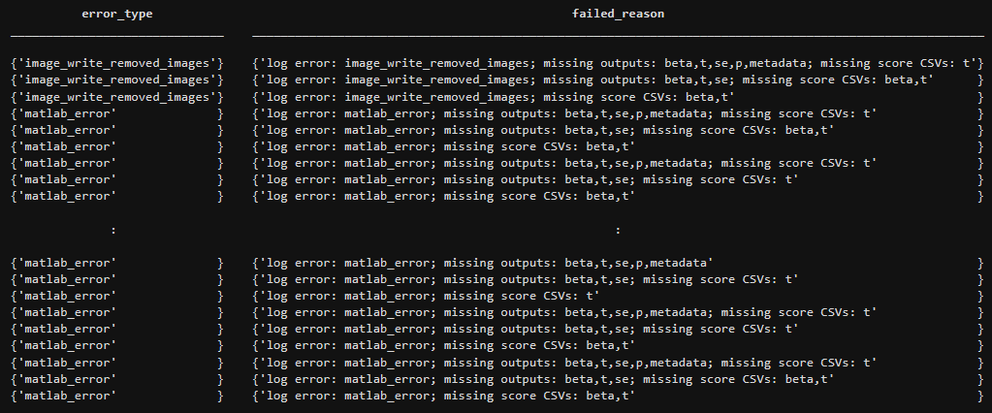
Study-Level Pipeline: HCP SLURM
output_dir = '//dartfs-hpc/rc/lab/C/CANlab/labdata/data/WASABI/derivatives/hrf_outputs_distractmap';
[audit, summary] = hrf_audit_slurm_outputs(output_dir, ...
'OutputCsv', fullfile(output_dir, 'hrf_slurm_audit.csv'));
summary = struct with fields:
manifest_file: '\\dartfs- hpc\rc\lab\C\CANlab\labdata\data\WASABI\derivatives\hrf_outputs_obs_distractmap\hrf_study_manifest.csv' config_mat: '\\dartfs- hpc\rc\lab\C\CANlab\labdata\data\WASABI\derivatives\hrf_outputs_obs_distractmap\hrf_study_config.mat' log_dir: '\\dartfs-hpc\rc\lab\C\CANlab\labdata\data\WASABI\derivatives\hrf_outputs_obs_distractmap\logs' expected_models: {'sfir' 'canonical' 'spline'} require_scores: 1 n_manifest_tasks: 27 n_expected_model_outputs: 81 n_core_complete: 27 n_complete: 0 n_missing_or_failed: 81 n_result_mats: 27 n_complete_tasks: 0 n_missing_or_failed_tasks: 27 error_types: {2×1 cell}
audit(~audit.complete, {'task_index','subject’, … 'run_label','model','error_type','failed_reason’})
Note: See if we can get SLURM to rerun any node that failed
* Double cpu/memory

Slide 10
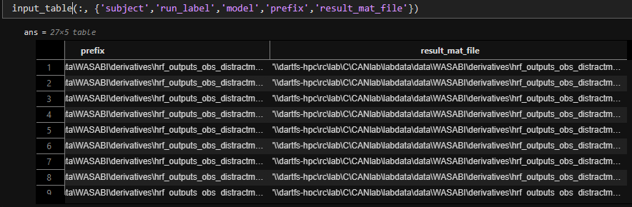
Study-Level Pipeline: HCP SLURM
output_dir = '//dartfs-hpc/rc/lab/C/CANlab/labdata/data/WASABI/derivatives/hrf_outputs_distractmap';
% After SLURM finishes:
input_table = hrf_collect_wholebrain_outputs(output_dir, 'OutputCsv', fullfile(output_dir, 'second_level_inputs.csv'));
[input_table, score_status] = hrf_score_wholebrain_input_table(input_table, ...
'SourceModel', {'sfir','canonical', 'spline'}, ...
'ScoreObjects', {'beta','t'}, ...
'SignatureSets', {'all'});
study_scores = hrf_input_table_to_study(input_table, ...
'Object', 'beta', ...
'SourceModel', 'sfir');

Slide 11
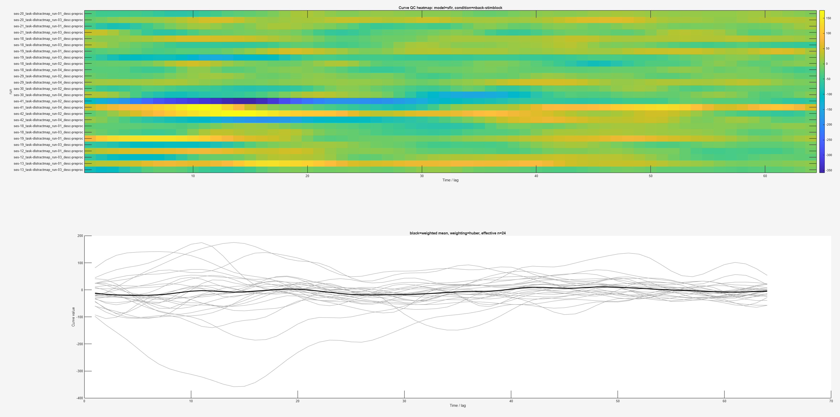
Study-Level Pipeline: Quality Control
qc = hrf_qc_study_curves(study_scores, ...
'Model', 'sfir', ...
'Signature', 'sig_all_NPS', ...
'Condition', 'nback-stimblock', ...
'Unit', 'run', ...
'Weighting', 'huber', ...
'Plot', true);
qc.table(qc.table.is_outlier, :)
index label subject n_runs max_abs_robust_z rms peak_abs auc_abs n_nan weight is_outlier _____ _____________________________________________ ___________ ______ ________________ ______ ________ _______ _____ _______ __________ 14 "ses-30_task-distractmap_run-04_desc-preproc" "SID001641" 1 4.9977 62.311 148.81 2948 0 0.80037 true 15 "ses-41_task-distractmap_run-02_desc-preproc" "SID001651" 1 11.204 177.99 358.07 9124.2 0 0.35703 true 16 "ses-41_task-distractmap_run-04_desc-preproc" "SID001651" 1 6.0293 85.831 174.66 4766 0 0.66343 true 17 "ses-42_task-distractmap_run-02_desc-preproc" "SID001651" 1 4.7097 81.405 175.26 4308.9 0 0.8493 true 18 "ses-42_task-distractmap_run-04_desc-preproc" "SID001651" 1 6.5752 80.907 185.91 4037.9 0 0.60834 true 25 "ses-13_task-distractmap_run-01_desc-preproc" "SID002328" 1 5.1974 67.458 138.05 3660.7 0 0.76961 true

Slide 12
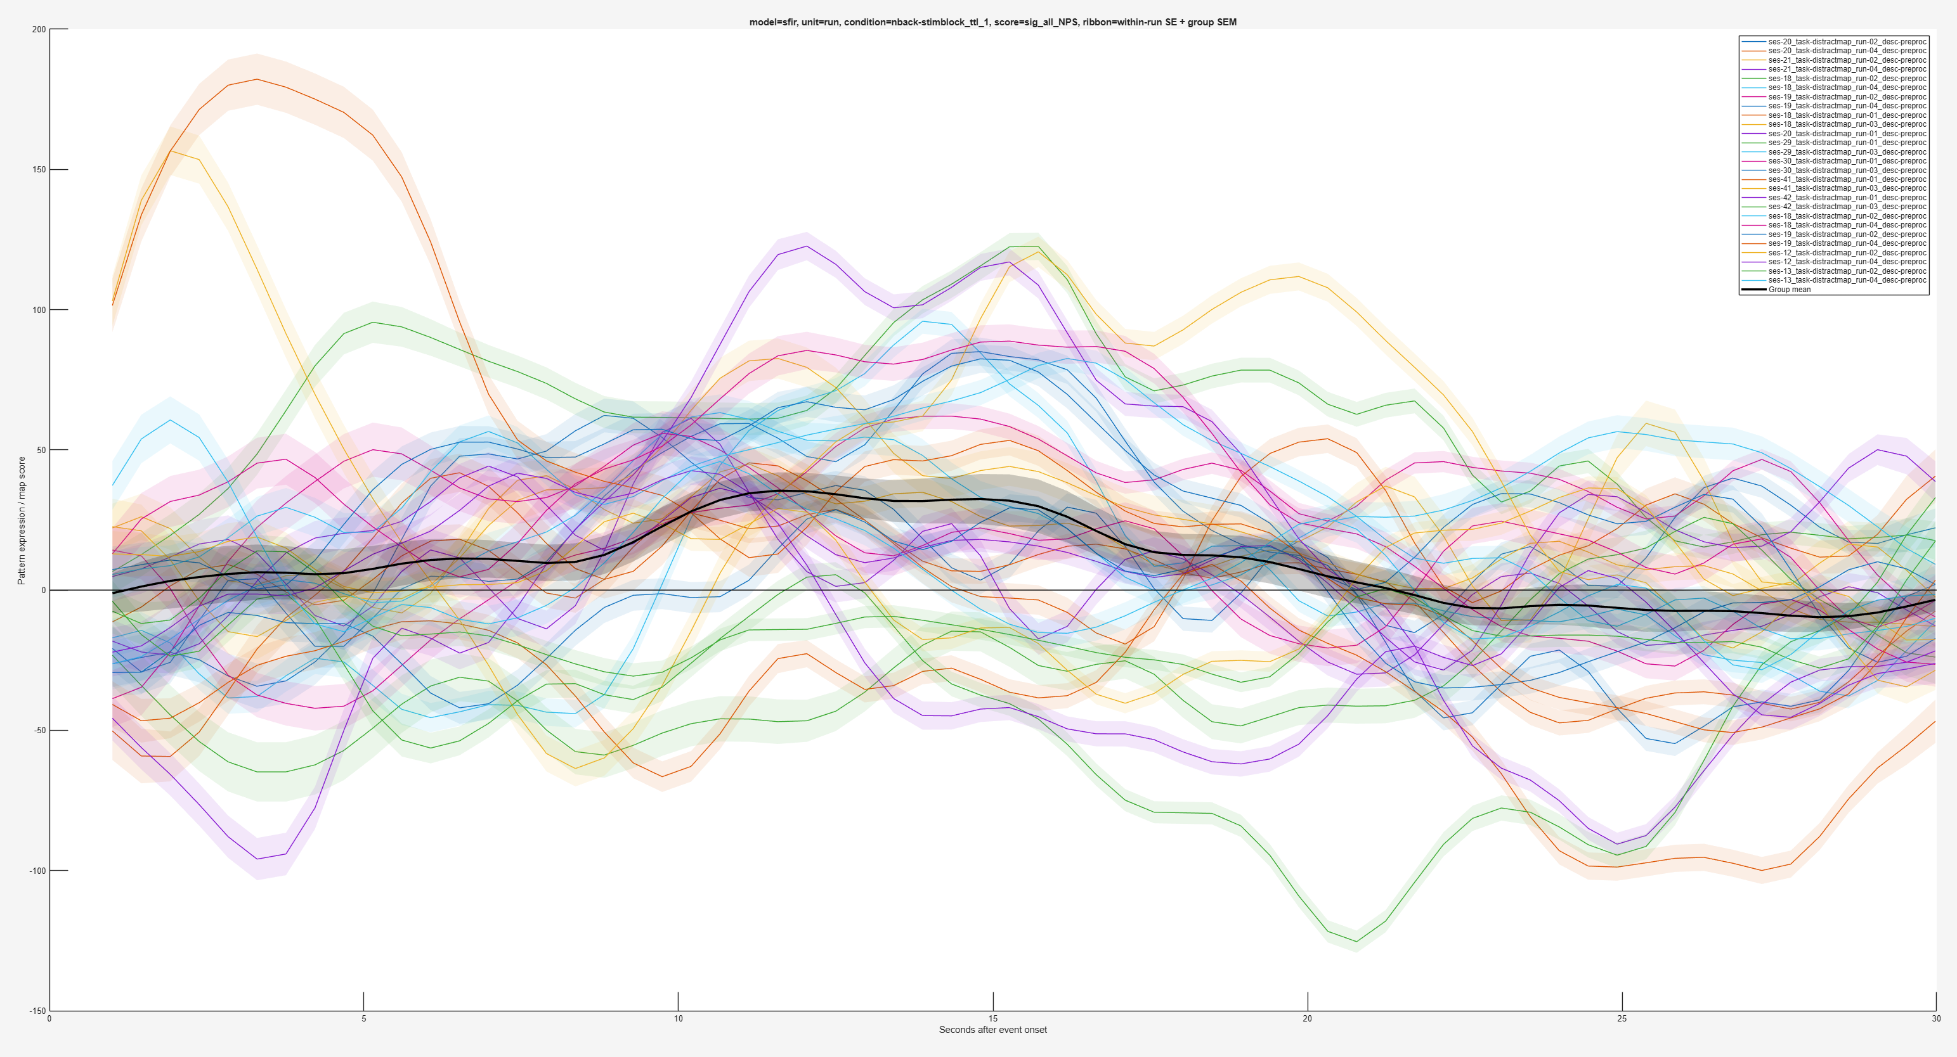
Study-Level Pipeline: Quality Control
plot_hrf_study_by_subject(study_scores_obs, ...
'Model', 'sfir', ...
'Unit', 'run', ...
'Condition', 'nback-stimblock_ttl_1', ...
'Signature', 'sig_all_NPS');

Slide 13
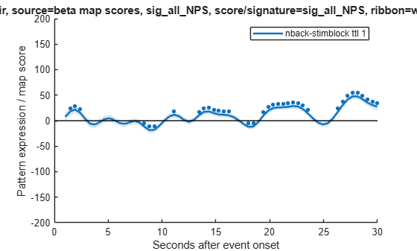
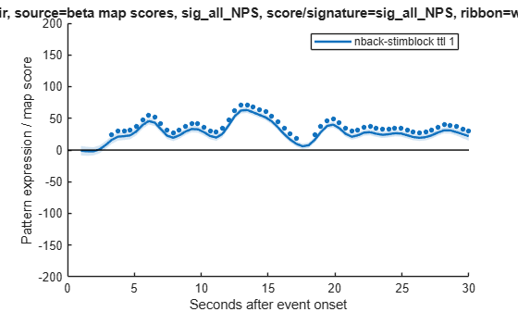
Study-Level Pipeline: Quality Control
plot_hrf_by_condition(study_scores.results{1}, ...
'Model', 'sfir', ...
'Signature', 'sig_all_NPS', ...
'Condition', 'nback-stimblock_ttl_1'); ylim([-200 200])
plot_hrf_by_condition(study_scores.results{2}, ...
'Model', 'sfir', ...
'Signature', 'sig_all_NPS', ...
'Condition', 'nback-stimblock_ttl_1'); ylim([-200 200])

Slide 14
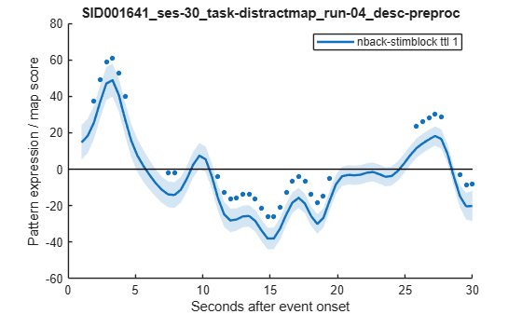
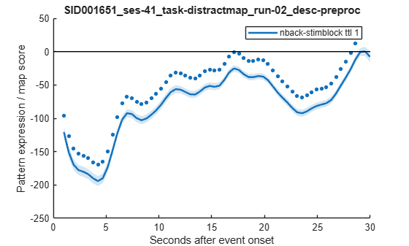
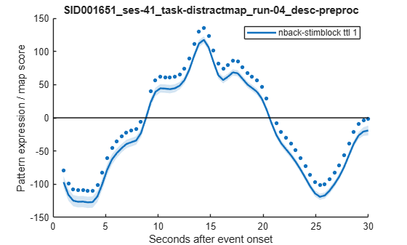
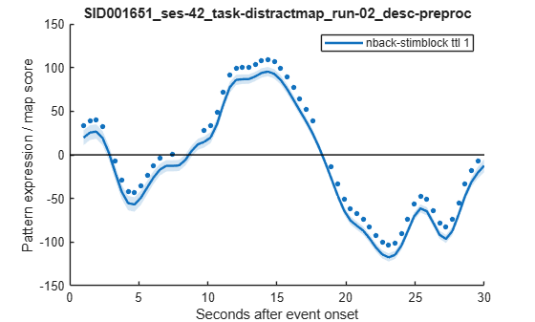
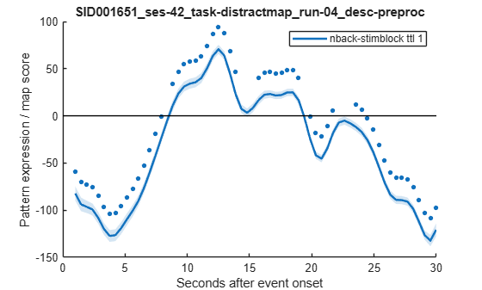
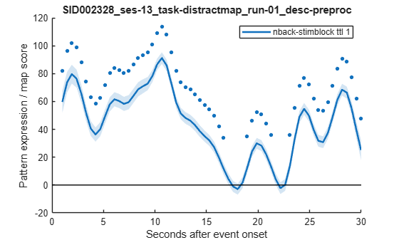
Study-Level Pipeline: Quality Control
for o = qc.table(qc.table.is_outlier, :).index'
plot_hrf_by_condition(study_scores_lf.results{o}, ...
'Signature', 'sig_all_NPS', ...
'Condition', 'nback-stimblock_ttl_1');
title(strcat(qc.table(o, :).subject, '_' , qc.table(o, :).label));
end

Slide 15
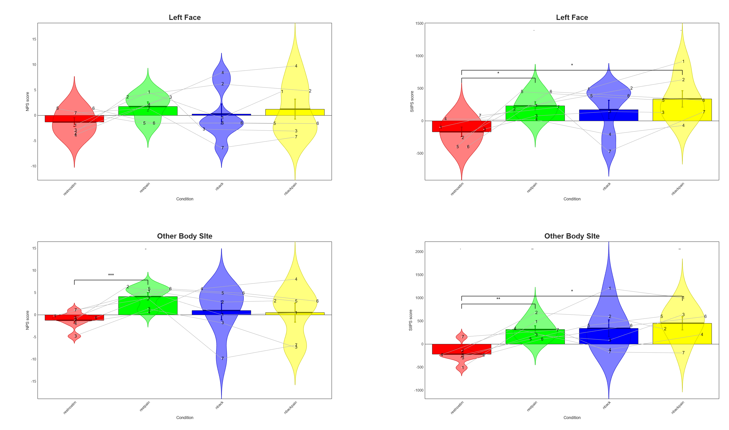
NPS
SIIPS

Slide 16
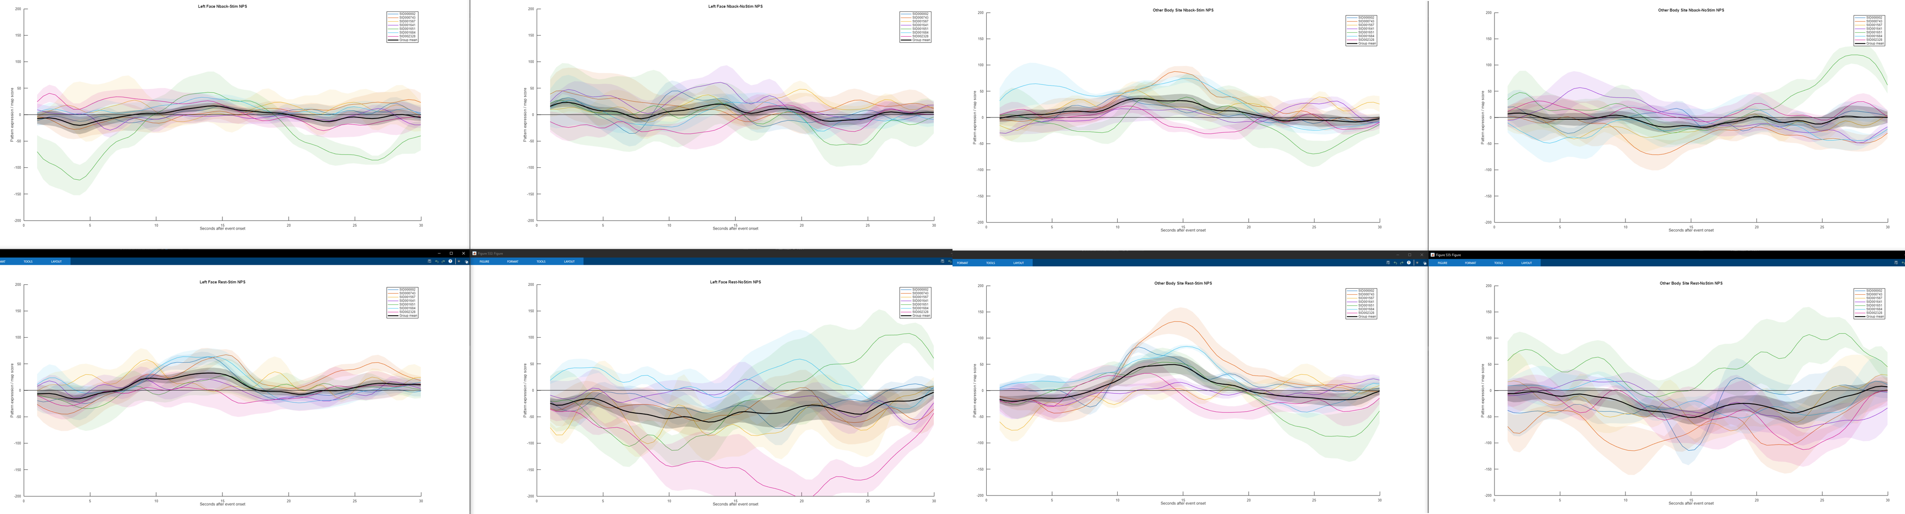
Case Study: DistractMap
plot_hrf_study_by_subject(study_scores, ...
'Model', 'sfir', ...
'Signature', 'sig_all_NPS', ...
'Condition', 'nback-stimblock_ttl_1');

Slide 17
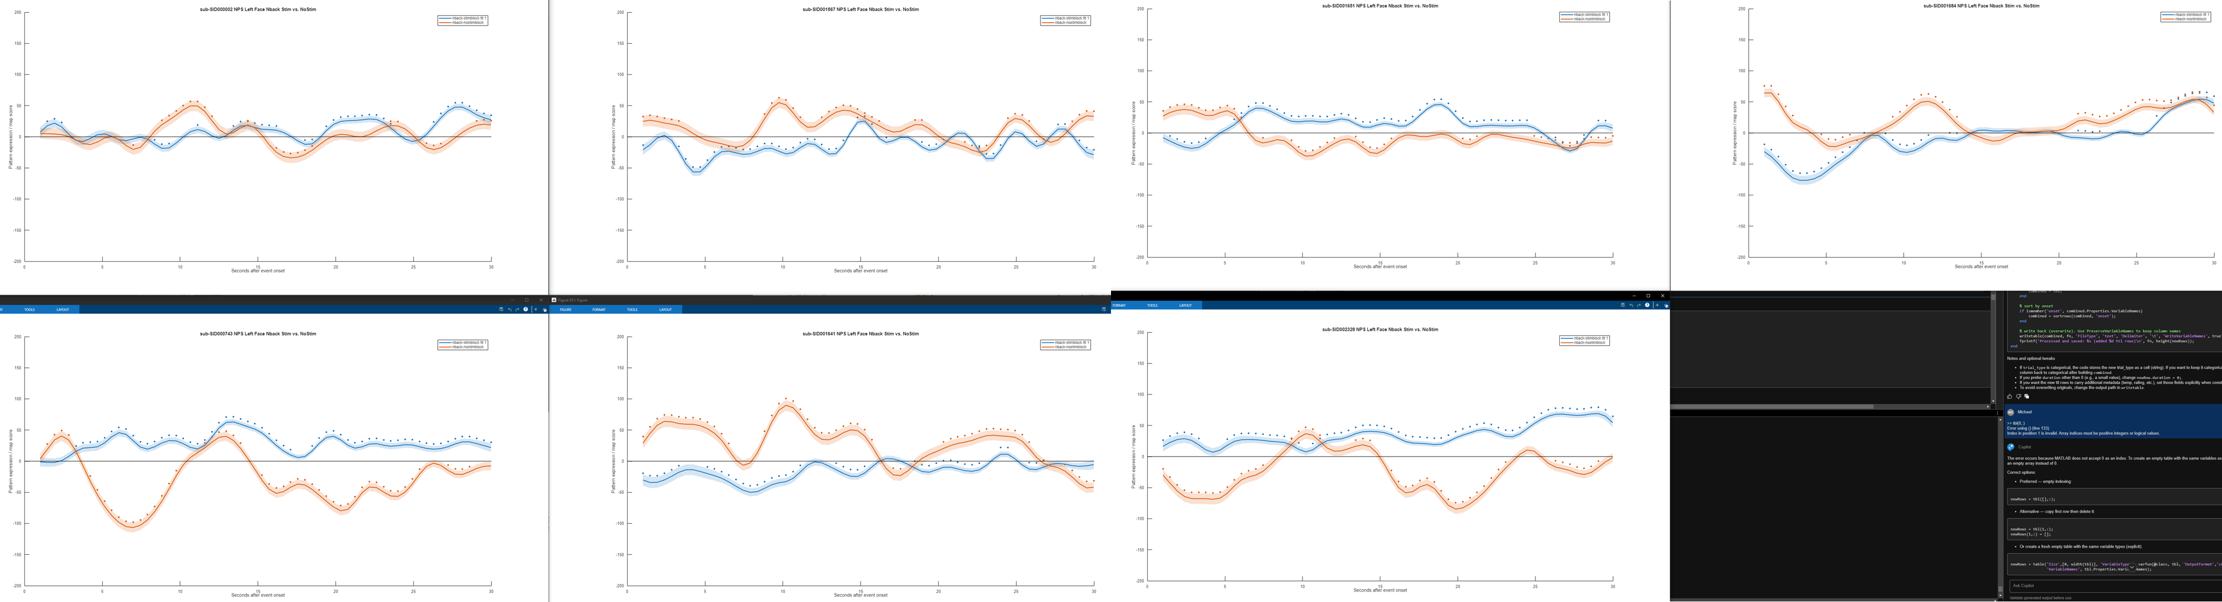
Case Study: DistractMap
for s = 1:7
try
plot_hrf_by_condition(study_scores.results{s}, ...
'Model', 'sfir', ...
'Signature', 'sig_all_NPS', ...
'Conditions', {'nback-stimblock_ttl_1','nback-nostimblock'});
ylim([-200 200])
title([subjects{s}, ' NPS Left Face Nback Stim vs. NoStim'])
catch
warning(['no fit for subject-', s]);
end
end

Slide 18
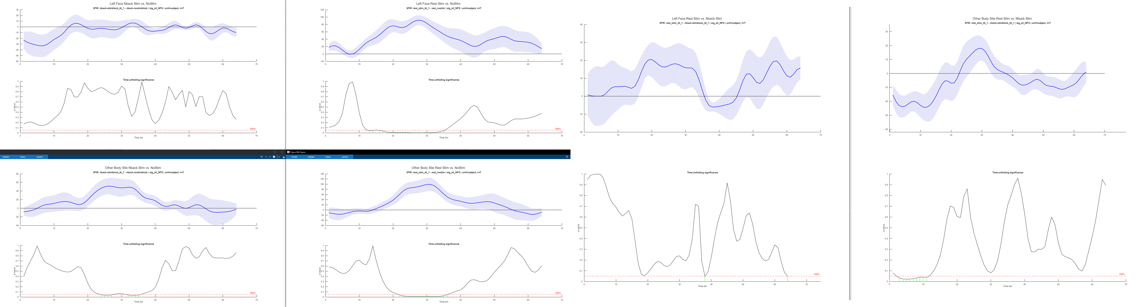
Case Study: DistractMap
Rest vs. Nback Effect
stats_nps = hrf_time_unfolding_stats(study_scores, ...
'Model', 'sfir', ...
'Signature', 'sig_all_NPS', ...
'ConditionA', 'nback-stimblock_ttl_1', ...
'Unit', 'subject', ...
'Alpha', 0.05);
plot_hrf_time_unfolding_stats(stats_nps);
No NPS Effect

Slide 19
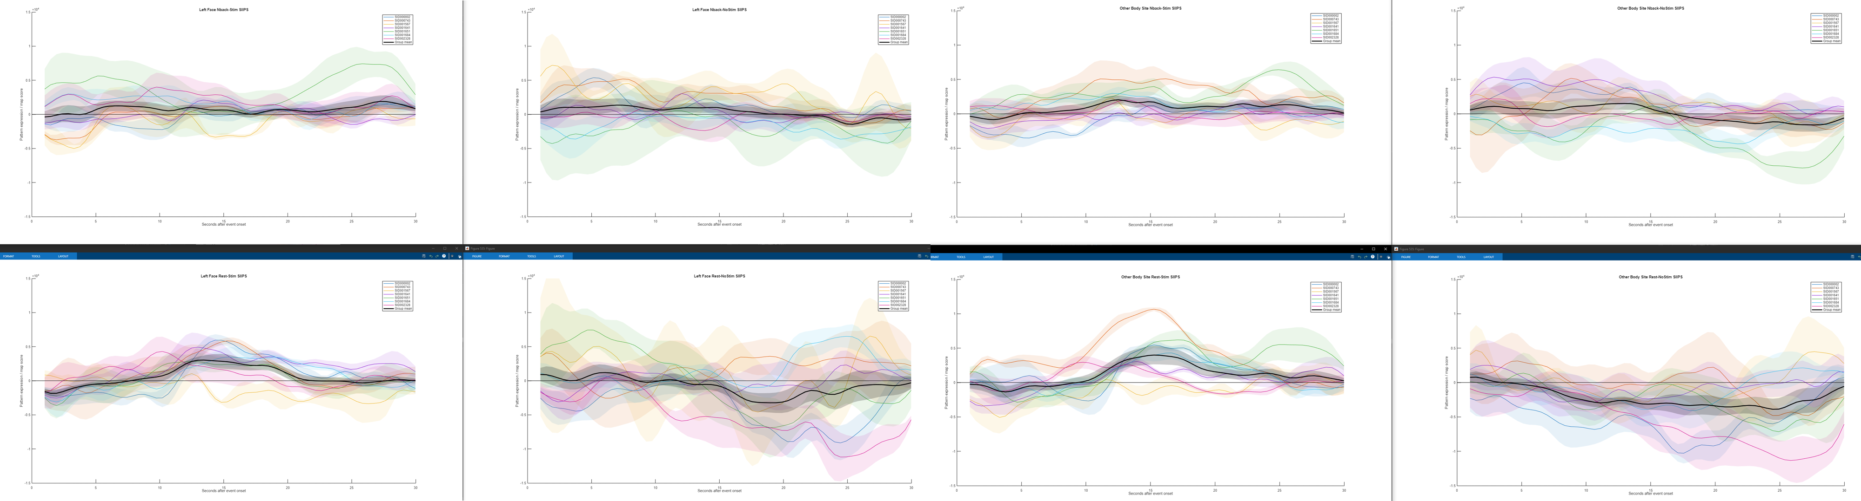
Case Study: DistractMap
plot_hrf_study_by_subject(study_scores, ...
'Model', 'sfir', ...
'Signature', 'sig_all_SIIPS', ...
'Condition', 'nback-stimblock_ttl_1');

Slide 20
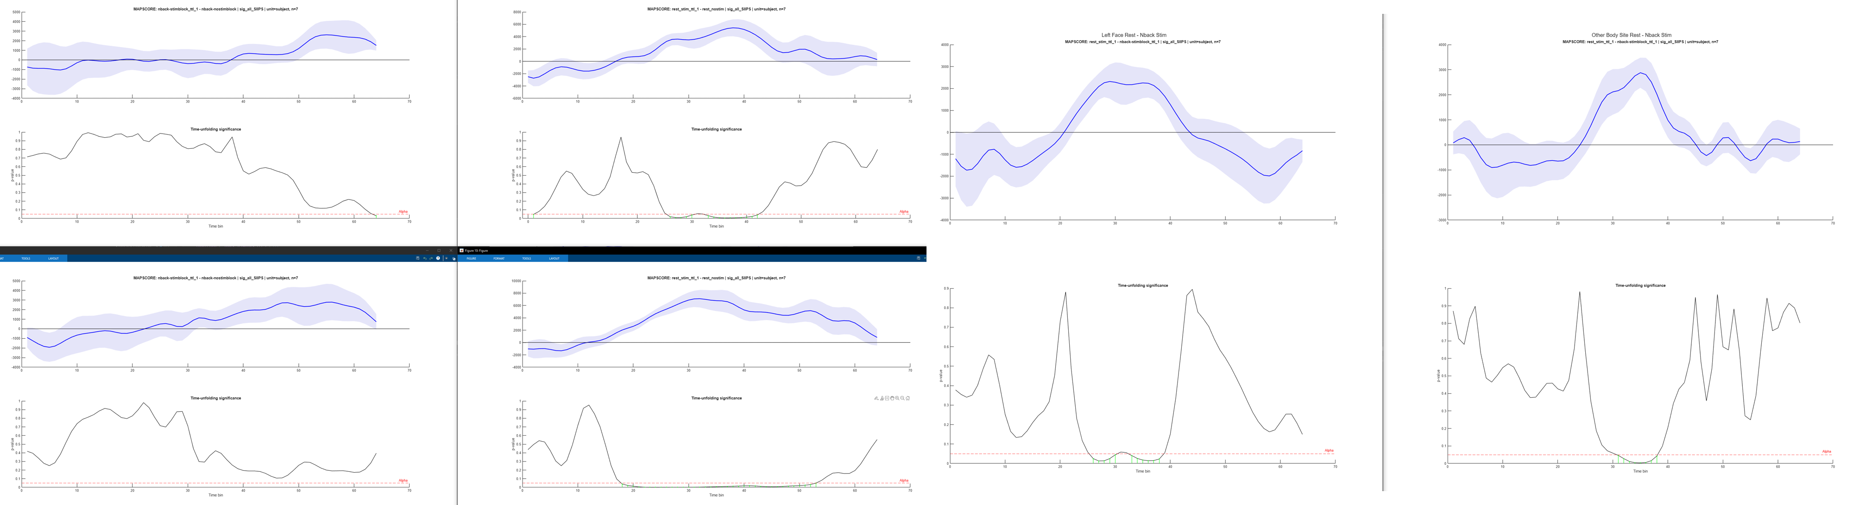
Case Study: DistractMap
Left Face Nback Stim vs. NoStim
Left Face Rest Stim vs. NoStim
Rest vs. Nback Effect
Other Body Site Nback Stim vs. NoStim
Other Body Site Rest Stim vs. NoStim
stats_nps = hrf_time_unfolding_stats(study_scores, ...
'Model', 'sfir', ...
'Signature', 'sig_all_SIIPS', ...
'ConditionA', 'nback-stimblock_ttl_1', ...
'ConditionB', 'nback-nostimblock', ...
'Unit', 'subject', ...
'Alpha', 0.05);
plot_hrf_time_unfolding_stats(stats_nps);
Significant SIIPS Effect
Nback reduces ‘extranociceptive’ engagement of pain

Slide 21
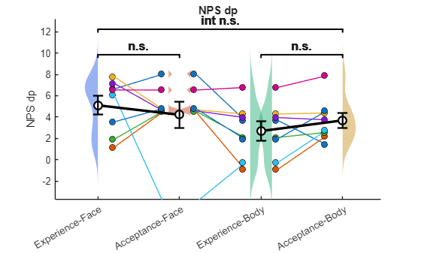
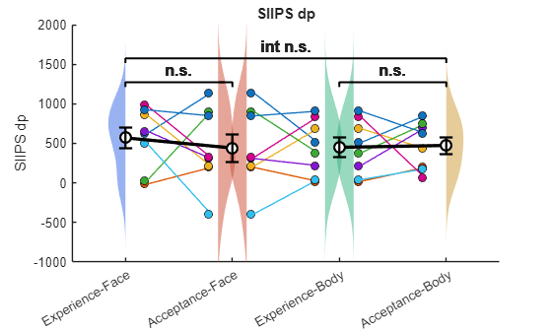
Case Study: AcceptMap

Slide 22
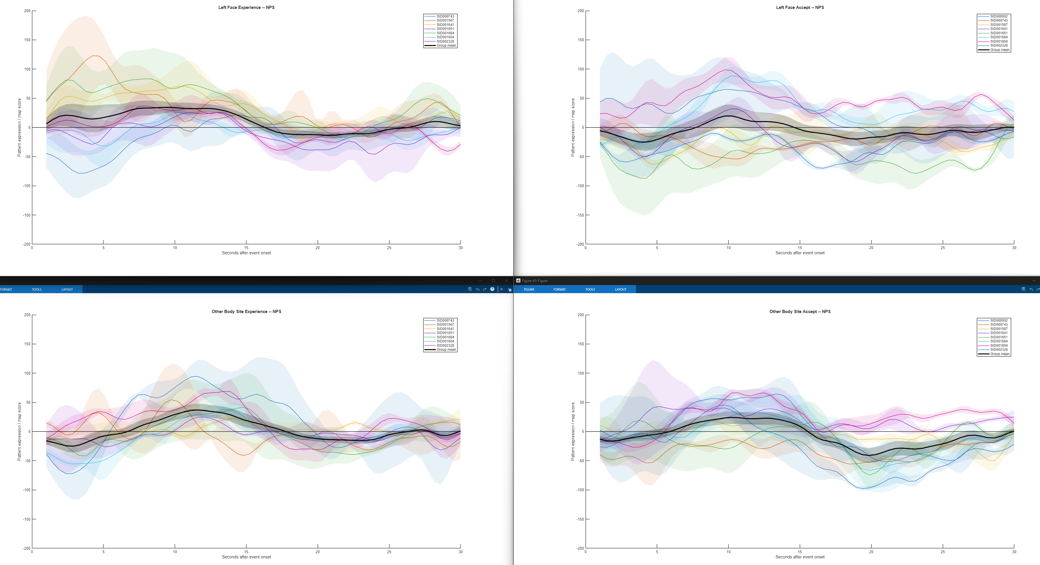

Slide 23
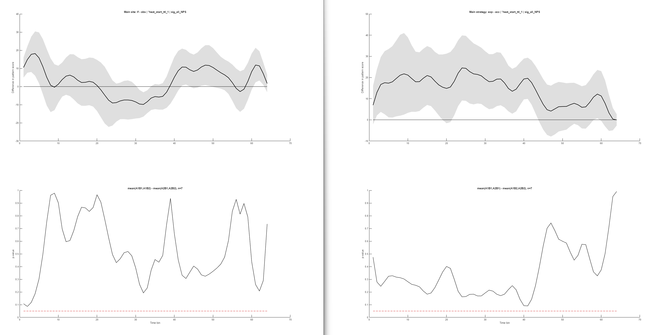
No Body Site Main Effect for NPS
No Acceptance Main Effect for NPS

Slide 24
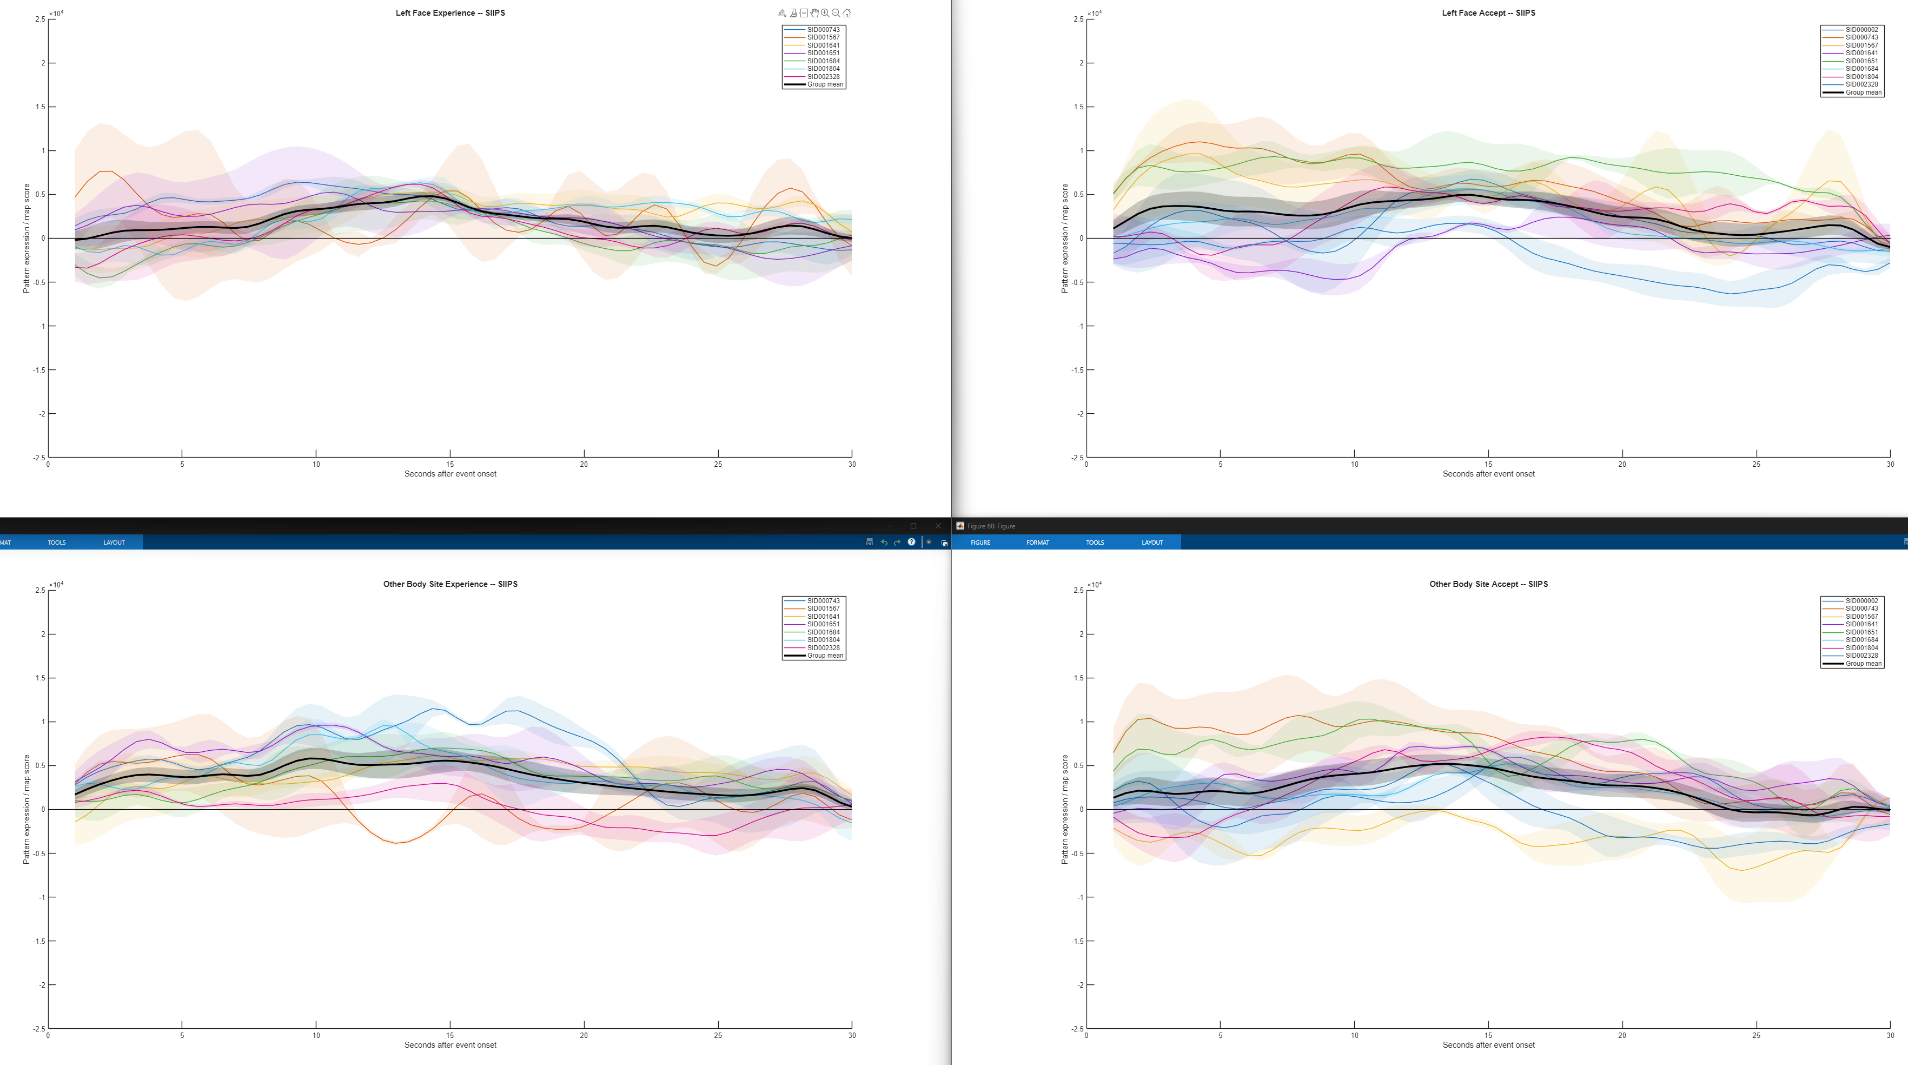

Slide 25
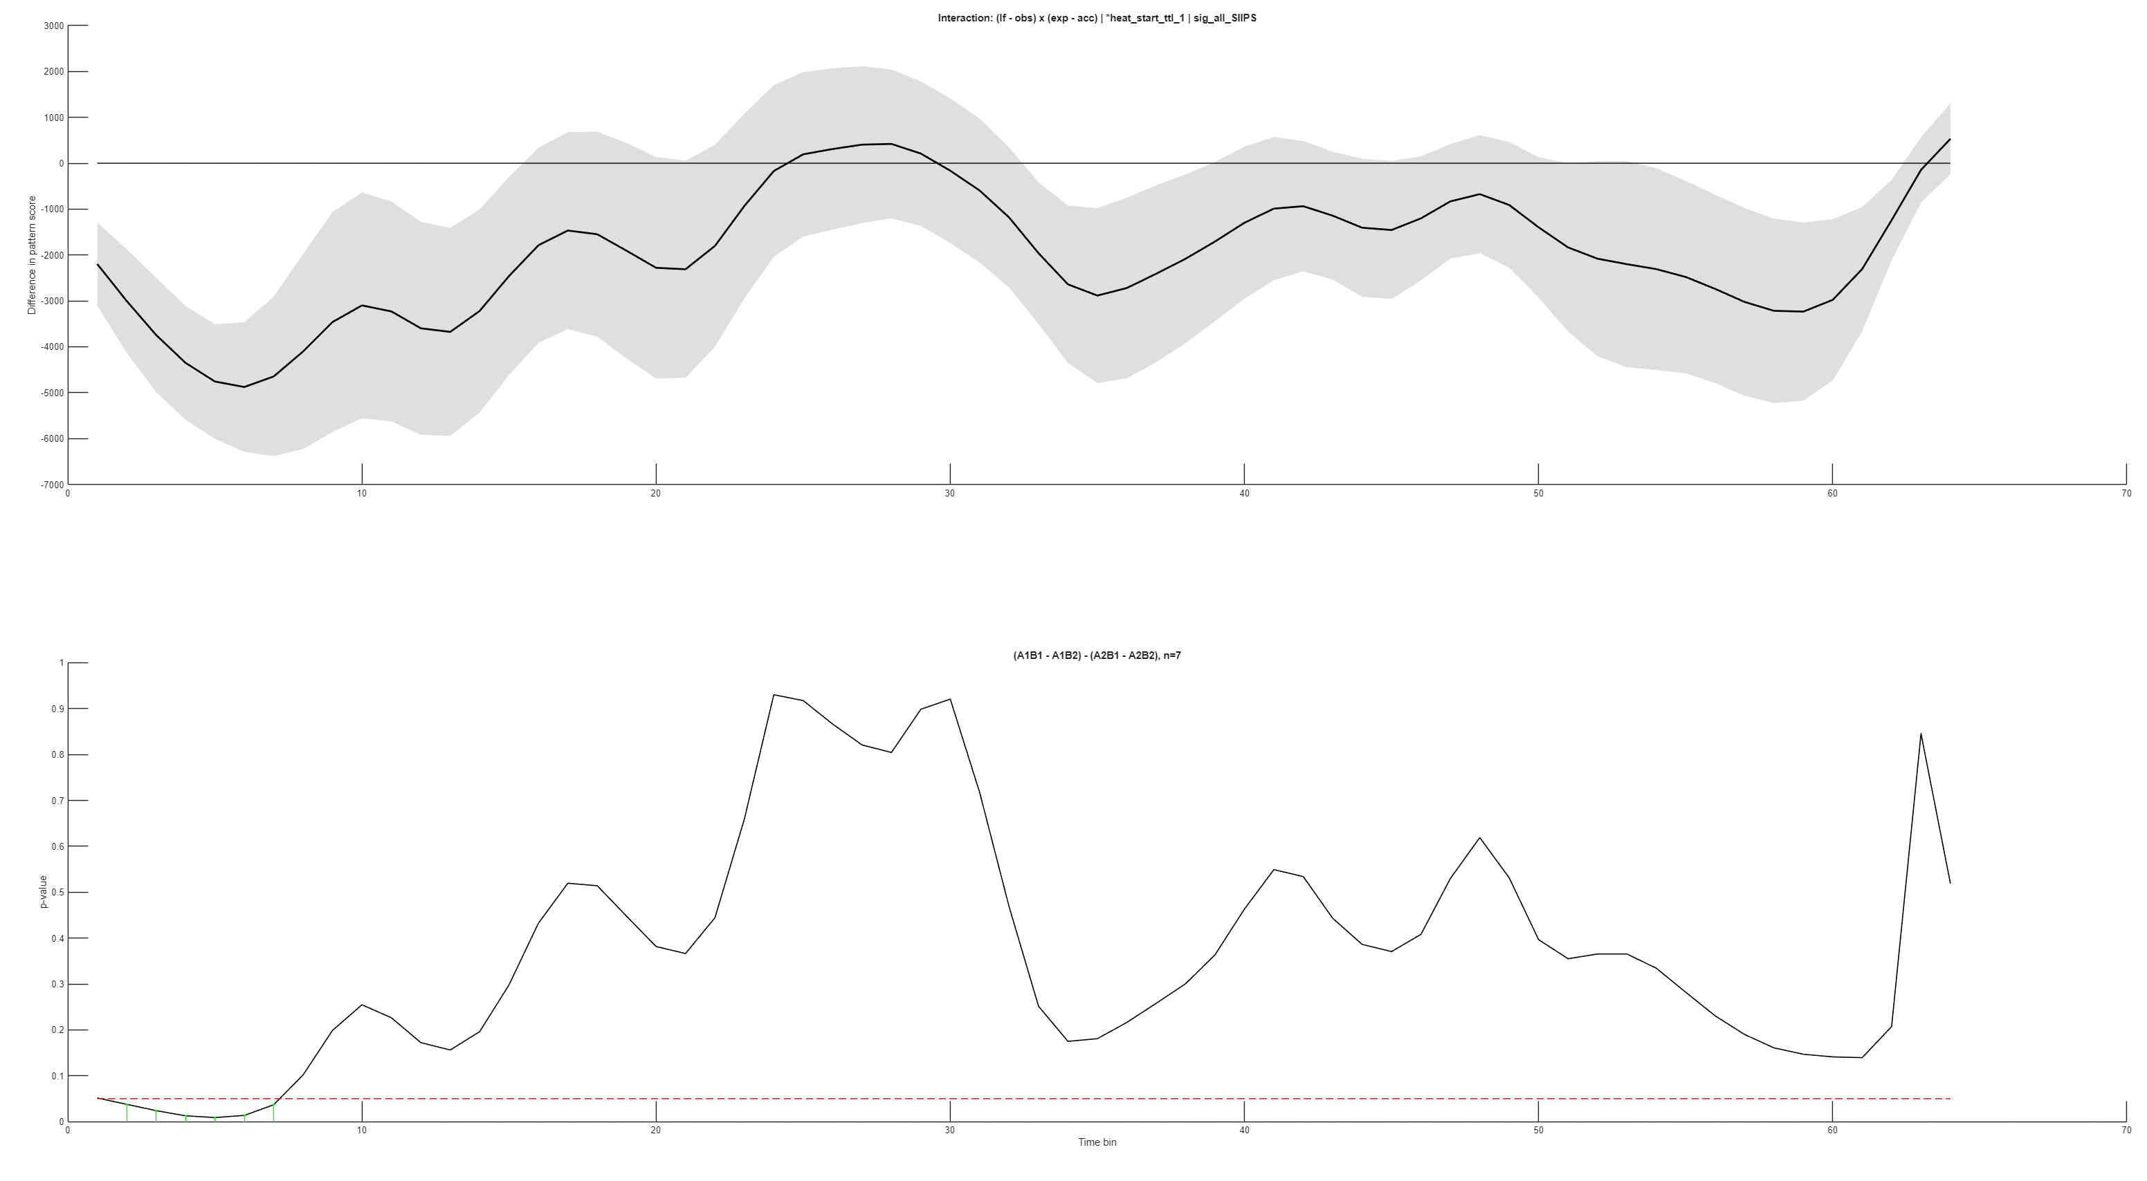
BodySite x Acceptance Effect*

Slide 26
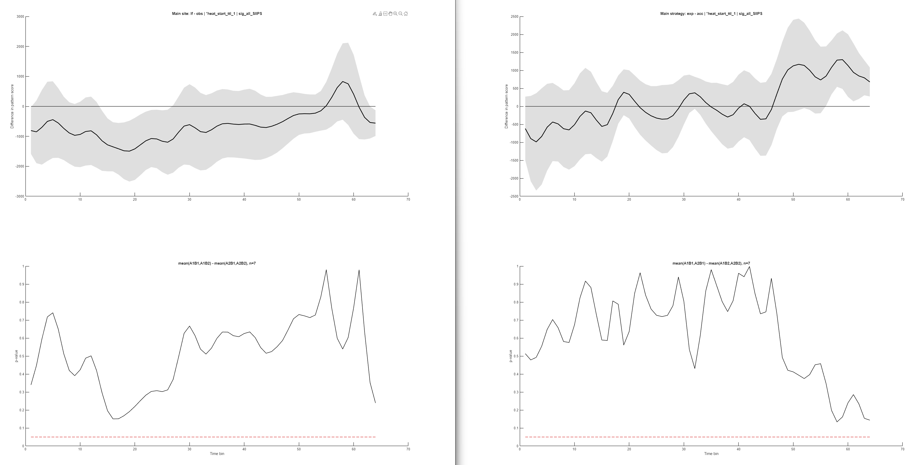
No SIIPS Main Effect for Body Site
No SIIPS Main Effect for Acceptance

Slide 27
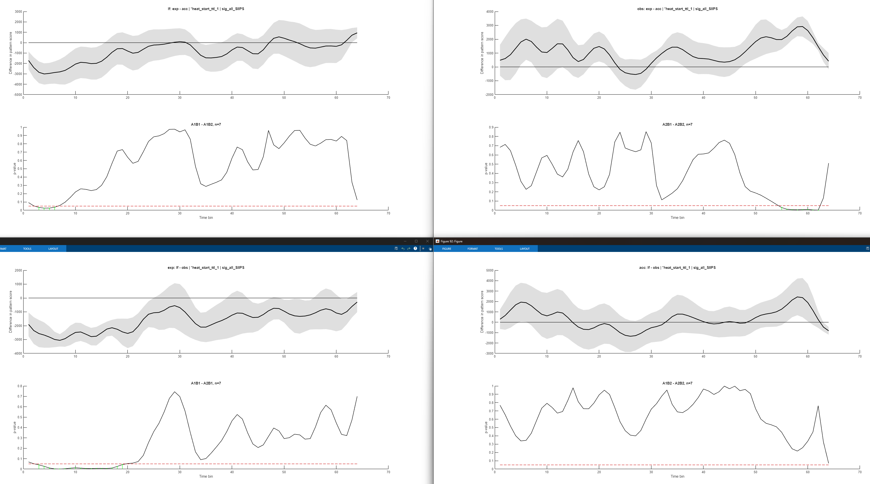
Left Face
Acceptance Effect*
Acceptance > Experience*
Experience
Body Site Effect*
Other Body Site > Left Face*

Slide 28
Design Plan Notes
Doesn’t yet commit to canlab / Always use objects?
Principle: Reuse core functionality. We should have only one glm_fit().

Slide 29
Should an hrf object hold one model or multiple models (so H.sfir, H.canonical, H.spline are siblings)? Single‑model is simpler; multi‑model is what the misspec pipeline needs. My instinct: single‑model class, plus an hrf_set container that holds a struct of hrf objects keyed by model name.
Should the 1D signature/ROI time series live on the hrf object, or on a parallel hrf_timeseries object? They share metadata but have very different storage.
Naming — hrf collides with the legacy hrf variable used throughout MATLAB SPM code. canlab_hrf, HRFObject, hrf_response? Tor's call.

